Slide 1

WCED Resources
2021 Theme
Transform to Perform
WCED Vision
WCED Mantra
Core Values with descriptions

Slide 4
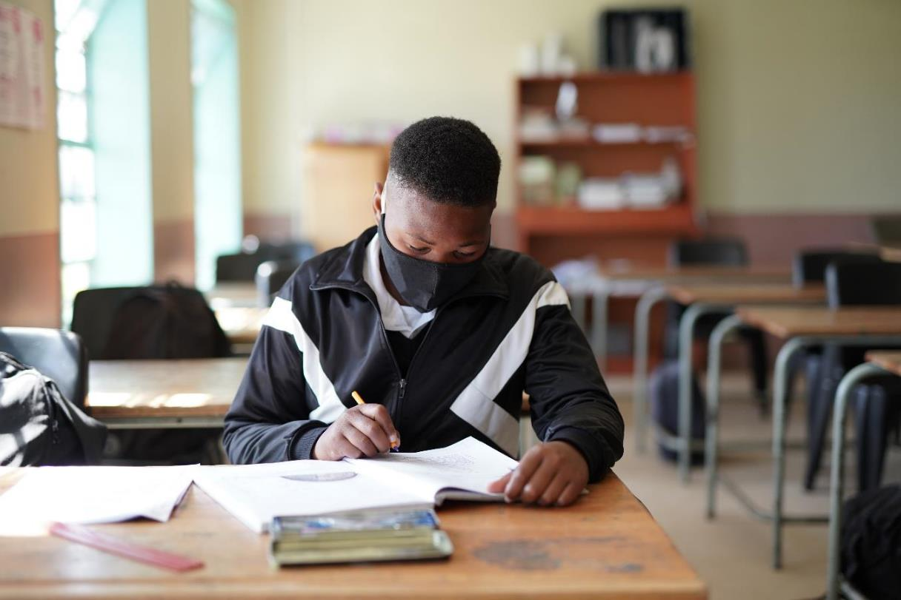
Quality Education
for every child
in every classroom
in every school
in the province.

Slide 5
Vision
Quality Education
for every child
in every classroom
in every school in the province.
Caring
Competence
Accountability
Integrity
Innovation
Responsiveness

Slide 6
Mantra

Slide 7
Mantra

Slide 8
OUR CORE VALUES
These values are our guiding principles for what we stand for and what we believe in.
Caring
To care for those we serve and work with.
Integrity
To be honest and do the right thing.
Competence
The ability and capacity to do the job we were employed to do.
Innovation
To be open to new ideas and develop creative solutions to problems in a resourceful way.
Accountability
We take responsibility.
Responsiveness
To serve the needs of our citizens and employees.

Slide 9
Our Core Values
Caring
To care for those we serve and work with.

Slide 10
Our Core Values
Competence
The ability and capacity to do the job we were employed to do.

Slide 11
Our Core Values
Accountability
We take responsibility.

Slide 12
Our Core Values
Integrity
To be honest and do the right thing.

Slide 13
Our Core Values
Innovation
To be open to new ideas and develop creative solutions to problems in a resourceful way.

Slide 14
Our Core Values
Responsiveness
To serve the needs of our citizens and employees.

Slide 18
Mantra

Slide 19
Mantra

Slide 20
OUR CORE VALUES
These values are our guiding principles for what we stand for and what we believe in.
Caring
To care for those we serve and work with.
Integrity
To be honest and do the right thing.
Competence
The ability and capacity to do the job we were employed to do.
Innovation
To be open to new ideas and develop creative solutions to problems in a resourceful way.
Accountability
We take responsibility.
Responsiveness
To serve the needs of our citizens and employees.

Slide 21
Our Core Values
Caring
To care for those we serve and work with.

Slide 22
Our Core Values
Competence
The ability and capacity to do the job we were employed to do.

Slide 23
Our Core Values
Accountability
We take responsibility.

Slide 24
Our Core Values
Integrity
To be honest and do the right thing.

Slide 25
Our Core Values
Innovation
To be open to new ideas and develop creative solutions to problems in a resourceful way.

Slide 26
Our Core Values
Responsiveness
To serve the needs of our citizens and employees.

Slide 27
Thank you

